Slide 1
Manual Home-build AFM
Bio-mechanics Lab
Lehigh University
Xiaohui (Frank) Zhang
Wei Zhang

Slide 2
Steps
Step 1: Turn on AFM controller; run Igor (afm-includeAll).
Step 2: Calibration
Step 3: Experiment

Slide 3
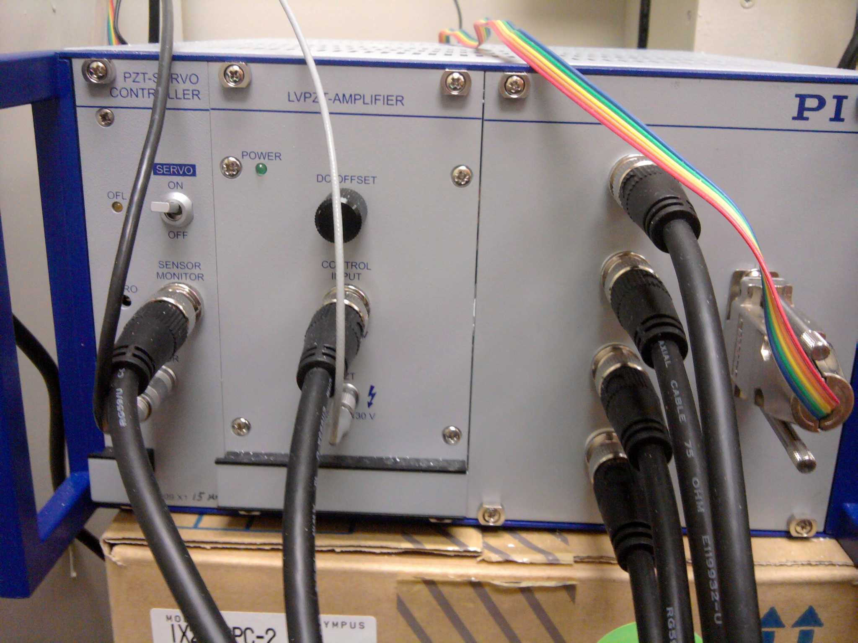
Step 1 – Turn on AFM Controller

Slide 4
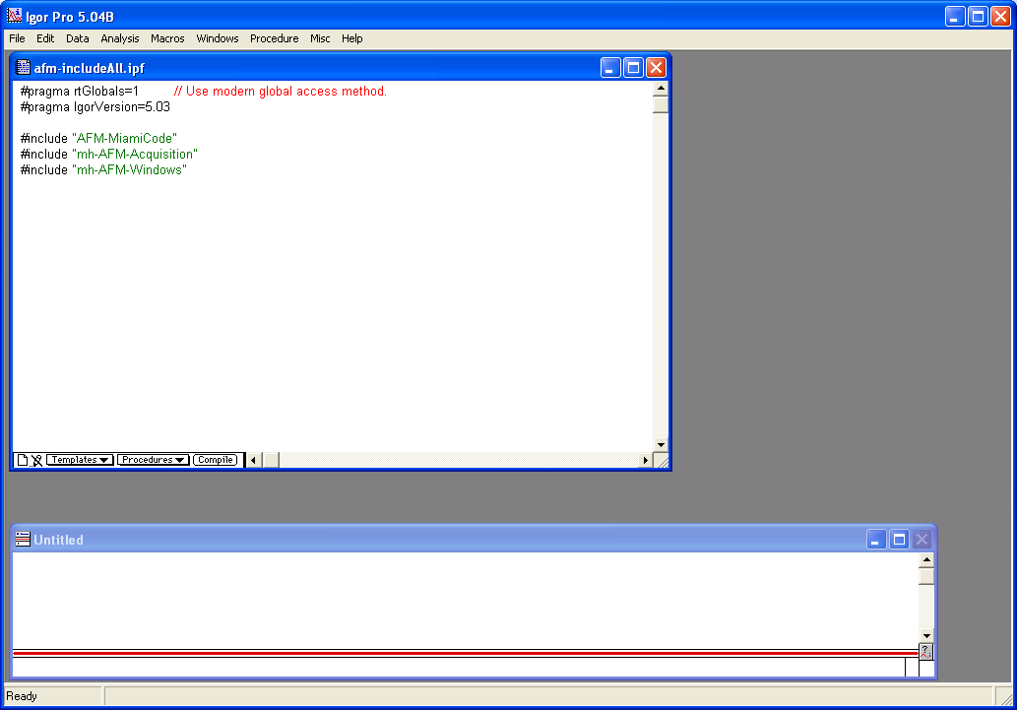
Step 1 – Run Igor (afm-includeAll)
Click Compile;
Go to Macros -> Init
Compile first

Slide 5
Step 2 - Calibration

